Slide 1
The Tortorella Family Foundation and Bear’s Angels Humane Education Program

Slide 2
Bookmark Lessons
By the Tortorella Family Foundation and Bear’s Angels

Slide 4
Objectives:
Teach us to keep pets healthy
Learn how fleas, heartworms and ticks can hurt our cats and dogs and the ways that we can protect our furry friends from these pests

Slide 5
Materials Needed:
“A Guide to Can You Help Detective Bear? Bookmark”
Brochure guide to the bookmarks
“Can you help Detective Bear?” Activity sheet
“Can you help Detective Bear?” Bookmark
Bear’s Cub Humane Education Certificate for end of all lessons

Slide 6
Activity Options for Students K-2
For Grades K-2:
Students can watch videos on fleas, ticks, and heartworm. The teacher can go through the slides with all the information from the hand out.
Students will complete Detective Bear’s Activity sheet, which goes along with the bookmark.
Students will earn a Bear’s Cub Humane Education Certificate after completing all three bookmarks!

Slide 7
Activity Options for Students Grades 3-6
For Grades 3-6:
Students can watch videos on fleas, ticks, and heartworm. The teacher can go through the slides with all the information from the hand out.
Students can read handout or brochure on their own or in partnerships or groups.
Students will complete Detective Bear’s Activity sheet, which goes along with the bookmark.
Students will earn a Bear’s Cub Humane Education Certificate after completing all three bookmarks!

Slide 8
Video Options on Fleas and Ticks
K-2:
Fleas: https://www.youtube.com/watch?v=SKyDrAyaAUA
Ticks: https://www.youtube.com/watch?v=sU8wLgXZ92M
3rd grade and up
General information on fleas and ticks: https://www.youtube.com/watch?v=ynEMFFj-PSM
Flea and Tick medication: https://www.youtube.com/watch?v=tBpaoz9z1Mw
Heartworm: https://www.youtube.com/watch?v=3XP92QliwgQ

Slide 9
Who is Detective Bear?
Even with his cap and trench coat, it’s easy to recognize that Detective Bear is a dog... a very special one at that!
Bear was the Tortorella Family’s pet and they loved him very much. After he passed away, the family decided to help animals in his name. They created Bear’s Angels , a program for shelters and rescues who do great things for animals in need.

Slide 10
In Honor of Bear

Slide 11
Help Detective Bear
The bookmark, Can You Help Detective Bear? asks readers to help discover what is “bugging” Detective Bear’s and his friends. By looking through Detective Bear’s magnifying glass, we find three different bugs that might be harmful to cats and dogs.
Fleas
Heartworm
Ticks

Slide 12
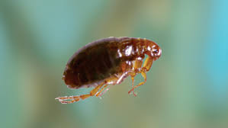
Fleas
Fleas are tiny insects, no more than 1/12” to 1/8” long.
They cannot fly but can jump very high for their size. If they jump onto an animal, such as a dog or cat, they can live in the animal’s fur for a long time.

Slide 13
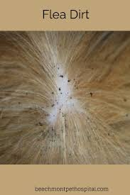
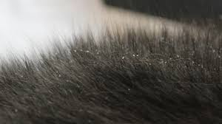
Fleas
The fleas lay eggs and in a short amount of time, a cat or dog can have hundreds of fleas. Fleas will bite the animal and cause discomfort (itching) and pain.
Fleas can cause skin diseases in animals and in humans.

Slide 14
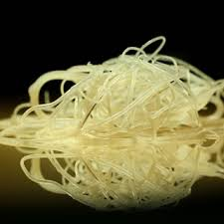
Heartworm
These worms most often attack dogs. The worms, when fully grown, are 1 foot long.
Heart worms get into a dog’s skin though a mosquito bite. The mosquito carries baby heartworms in its blood from biting an animal that has already been infected with heartworms. This is how a mosquito spreads heartworms from one dog to another.

Slide 15
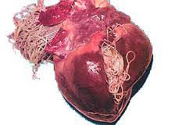
Heartworm
The baby heartworms find their way into a dog’s heart and lungs where they grow and lay eggs.
Heartworms can seriously damage an animal’s lungs and heart and if they are not treated with special medication, the animal can become very ill and die.

Slide 16
Heartworm

Slide 17
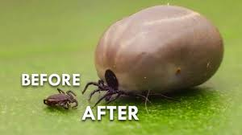
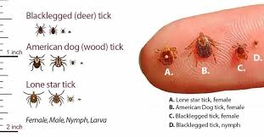
Ticks
Ticks are arachnids - animals that have eight legs, like spiders. They don’t fly or jump, but live in the grass and bushes.
Ticks can attach themselves to cats and dogs when those animals walk through the grass or bushes.

Slide 18
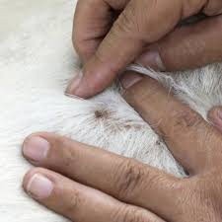
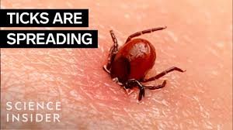
Ticks
They can even attach themselves to humans. Ticks insert their mouth under an animal’s skin and feed off of its blood.
They can pass along diseases to the animal. One disease caused by ticks is Lyme disease. This is a disease that causes the swelling of the joints in the animal’s legs and makes walking or moving very painful.

Slide 19
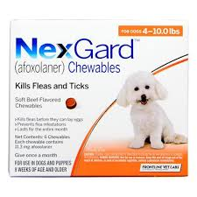
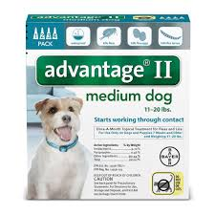
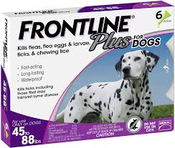
How can we help our pets so that they won’t get sick?
There are special medicines to prevent and treat disease from ticks, fleas and heartworms.
See video on flea and tick medication: https://www.youtube.com/watch?v=tBpaoz9z1Mw
It is important for us to talk to a veterinarian to learn more about these medications.

Slide 20
Now it’s bookmark time!
Answer the questions based on what you learned from the slides, videos, the bookmark, the guide, and brochure.
Complete the activity sheet for this lesson and answers can be written on the bookmarks at another time.
You can then earn a Bear’s Cub Humane Education Certificate after completing all three bookmarks!

Slide 21
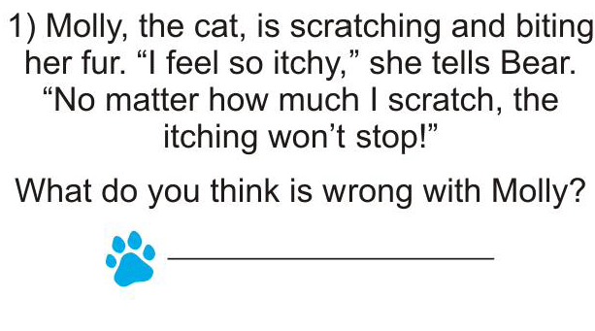

Slide 22
Answer 1:
She has fleas.

Slide 23
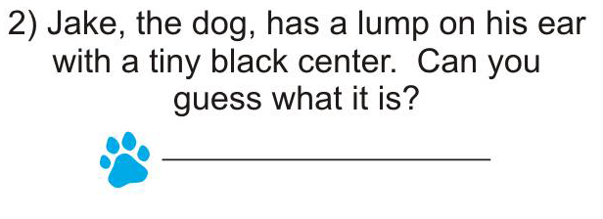

Slide 24
Answer 2:
It is a tick.

Slide 26
Answer 3:
C. Heart-worms

Slide 28
Miss Kitty Watson’s - Helping Community Cats Bookmark

Slide 29
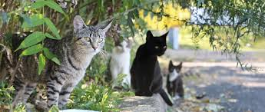
Objectives:
Teach us to keep pets healthy
Teach us about community and feral cats.

Slide 30
Materials Needed:
A Guide to Detective Bear and Miss Kitty Watson’s -Helping Community Cats Bookmark
Brochure guide to the bookmarks
Miss Kitty Watson’s Activity sheet
Detective Bear and Miss Kitty Watson’s -Helping Community Cats Bookmark
Bear’s Cub Humane Education Certificate for end of all lessons

Slide 31
Activity Options for Students K-2
For Grades K-2:
Students can watch videos on helping community cats. The teacher can go through the slides with all the information from the hand out.
Students will complete Miss Kitty Watson’s Activity sheet, which goes along with the bookmark, the guide, and brochure.
Students will earn a Bear’s Cub Humane Education Certificate after completing all three bookmarks!

Slide 32
Activity Options for Students Grades 3-6
For Grades 3-6:
Students can watch videos on helping community cats. The teacher can go through the slides with all the information from the hand out.
Students can read the guide, “A Guide to Detective Bear and Miss Kitty Watson’s -Helping Community Cats Bookmark,” on their own or in partnerships or groups and/or the brochure.
Students will complete Miss Kitty Watson’s Activity sheet, which goes along with the bookmark and the guide.
Students will earn a Bear’s Cub Humane Education Certificate after completing all three bookmarks!

Slide 33
Video Options on community and feral cats.
K-2
https://www.youtube.com/watch?v=bYKOdR2rJsw
https://www.youtube.com/watch?v=1lOd7rDFYbc
3rd grade and up:
https://www.youtube.com/watch?v=fTCTuJRkvng
https://youtu.be/I6DjFX3rgJo
https://www.youtube.com/watch?v=1lOd7rDFYbc

Slide 34
Who is Miss Kitty Watson?
Bear’s Angels , a program created for shelters and rescues who do great things for animals in need.
With this bookmark, we meet Detective Bear’s new friend, Miss Kitty Watson.
Through the Helping Community Cats bookmark, Detective Bear and Miss Kitty Watson talk about community or feral cats.

Slide 35
Now it’s bookmark time!
Answer the questions based on what you learned from the slides, videos, the bookmark, the guide, and brochure.
Complete the activity sheet for this lesson and answers can be written on the bookmarks at another time.
You can then earn a Bear’s Cub Humane Education Certificate!

Slide 36
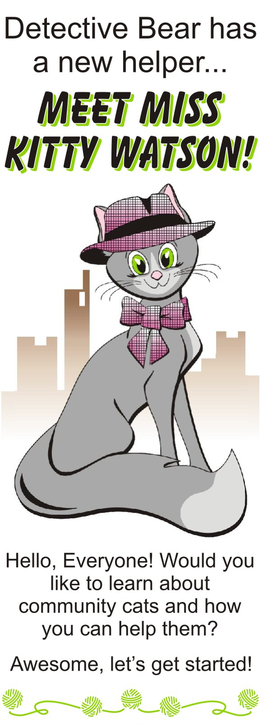
Detective Bear and Miss Kitty Watson explain how children can help the cats.
Please note that the words in the puzzle can be up or down or diagonal. They can be backwards, too.
Several words in their description are highlighted. Find those highlighted words in a puzzle.

Slide 37
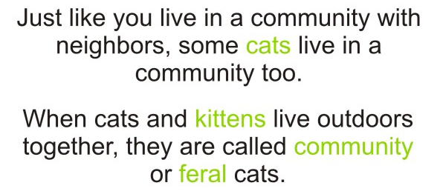
Words to find:
cats
kittens
community
feral

Slide 38
Words to find:
food
water
shelters

Slide 41
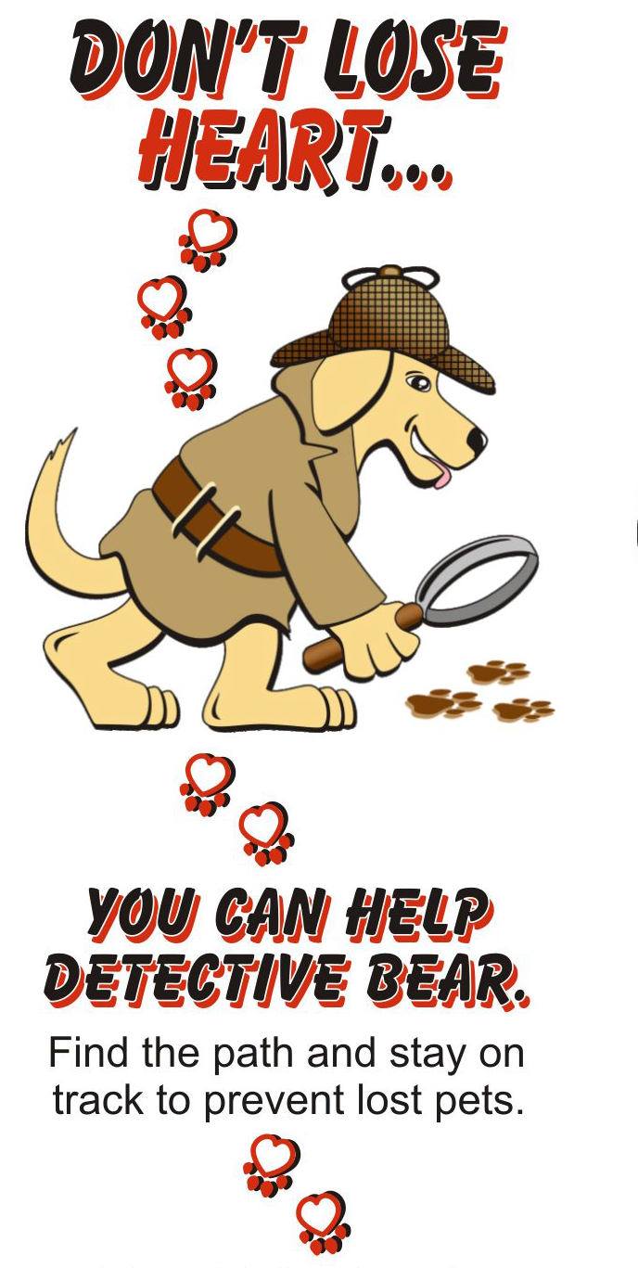

Slide 42
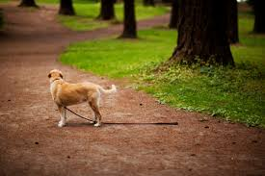
ID tags and Micro Chipping

Slide 43
Objectives:
Teach us to keep pets safe and healthy
Teaches us how wearing an ID tag and micro chipping can help an animal if he or she becomes lost.

Slide 44
Materials Needed:
A Guide to Detective Bear’s “Don’t Lose Heart” Bookmark
Brochure guide to the bookmarks
“Don’t Lose Heart” Activity sheet
“Don’t Lose Heart” Bookmark
Bear’s Cub Humane Education Certificate for end of all lessons

Slide 45
Activity Options for Students K-2
For Grades K-2:
Students can watch videos ID tags and micro chipping. The teacher can go through the slides with all the information from the hand out.
Students will complete Bear’s “Don’t Lose Heart Bookmark” Activity sheet, which goes along with the bookmark.
Students will earn a Bear’s Cub Humane Education Certificate after completing all three bookmarks!

Slide 46
Activity Options for Students Grades 3-6
For Grades 3-6:
Students can watch videos on ID tags and micro chipping. The teacher can go through the slides with all the information from the hand out.
Students can read handout on their own or in partnerships or groups.
Students will complete Bear’s “Don’t Lose Heart” Bookmark Activity sheet, which goes along with the bookmark.
Students will earn a Bear’s Cub Humane Education Certificate after completing all three bookmarks!

Slide 47
Video Options on micro chipping
K-2
Micro chipping:
https://youtu.be/n0kySDFlxlQ
https://www.youtube.com/watch?v=TiowQx0ieP8
3rd grade and up:
Micro chipping:
https://www.youtube.com/watch?v=TiowQx0ieP8
https://www.youtube.com/watch?v=uKN-mS-0fPg
I. D Tags and Micro chipping
https://youtu.be/V1-jrN8qReM

Slide 48
Now it’s bookmark time!
Answer the questions based on what you learned from the slides, videos, the bookmark, the guide, and brochure.
Complete the activity sheet for this lesson and answers can be written on the bookmarks at another time.
You can then earn a Bear’s Cub Humane Education Certificate!

Slide 51
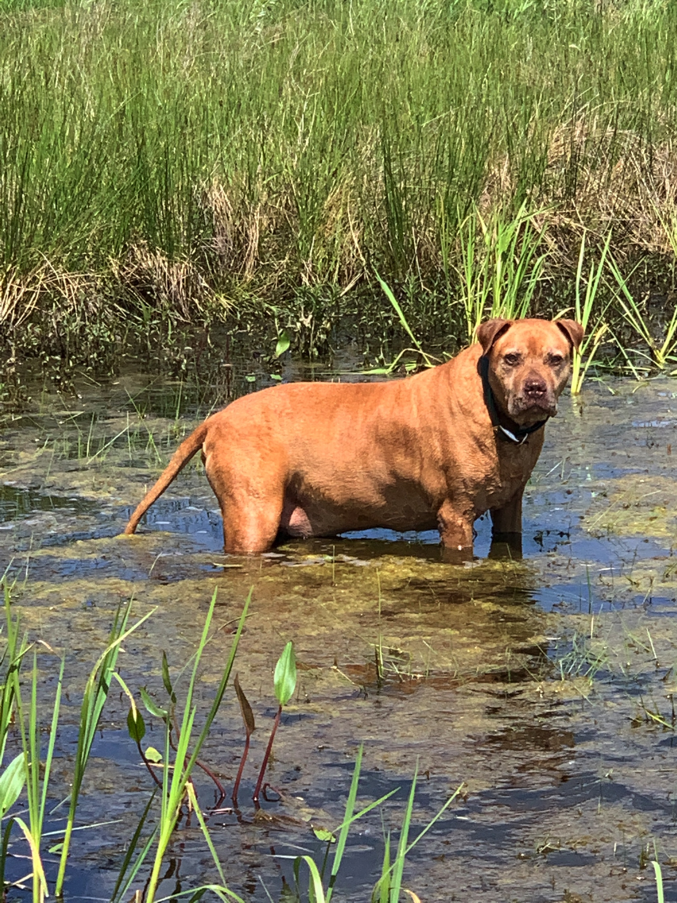
Blaze

Slide 52
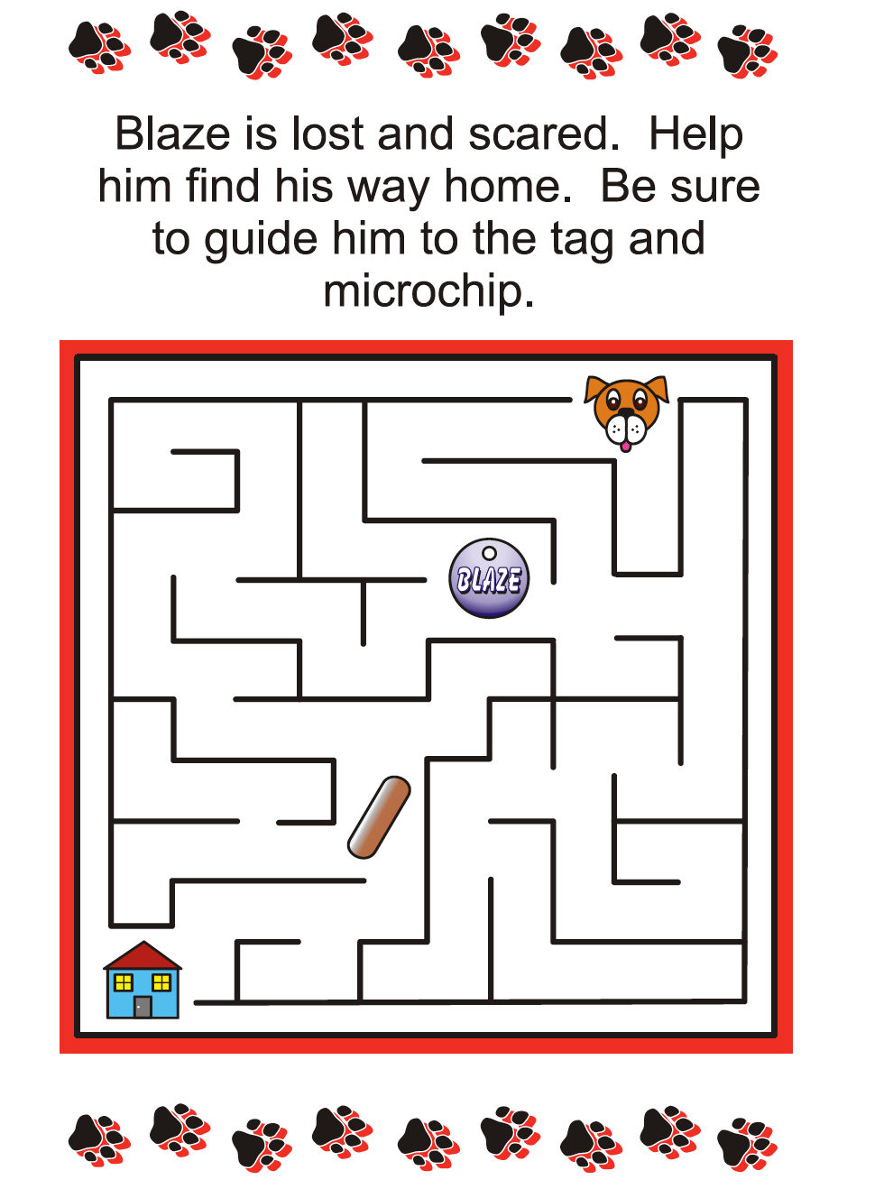

Slide 53
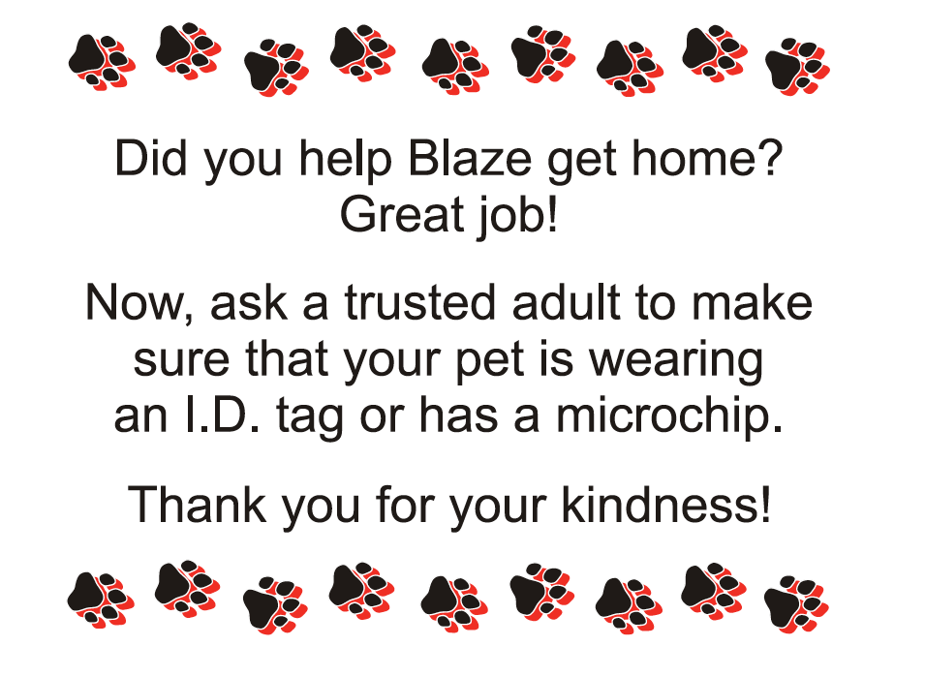

Slide 54
To print all the materials from this program:
https://www.dobugshavebellybuttons.com/educational-materials/
To learn more about our programs, please visit our website at:
www.tortorellafoundation.org and our Facebook
page www.facebook.com/tortorellafoundation

